Slide 1
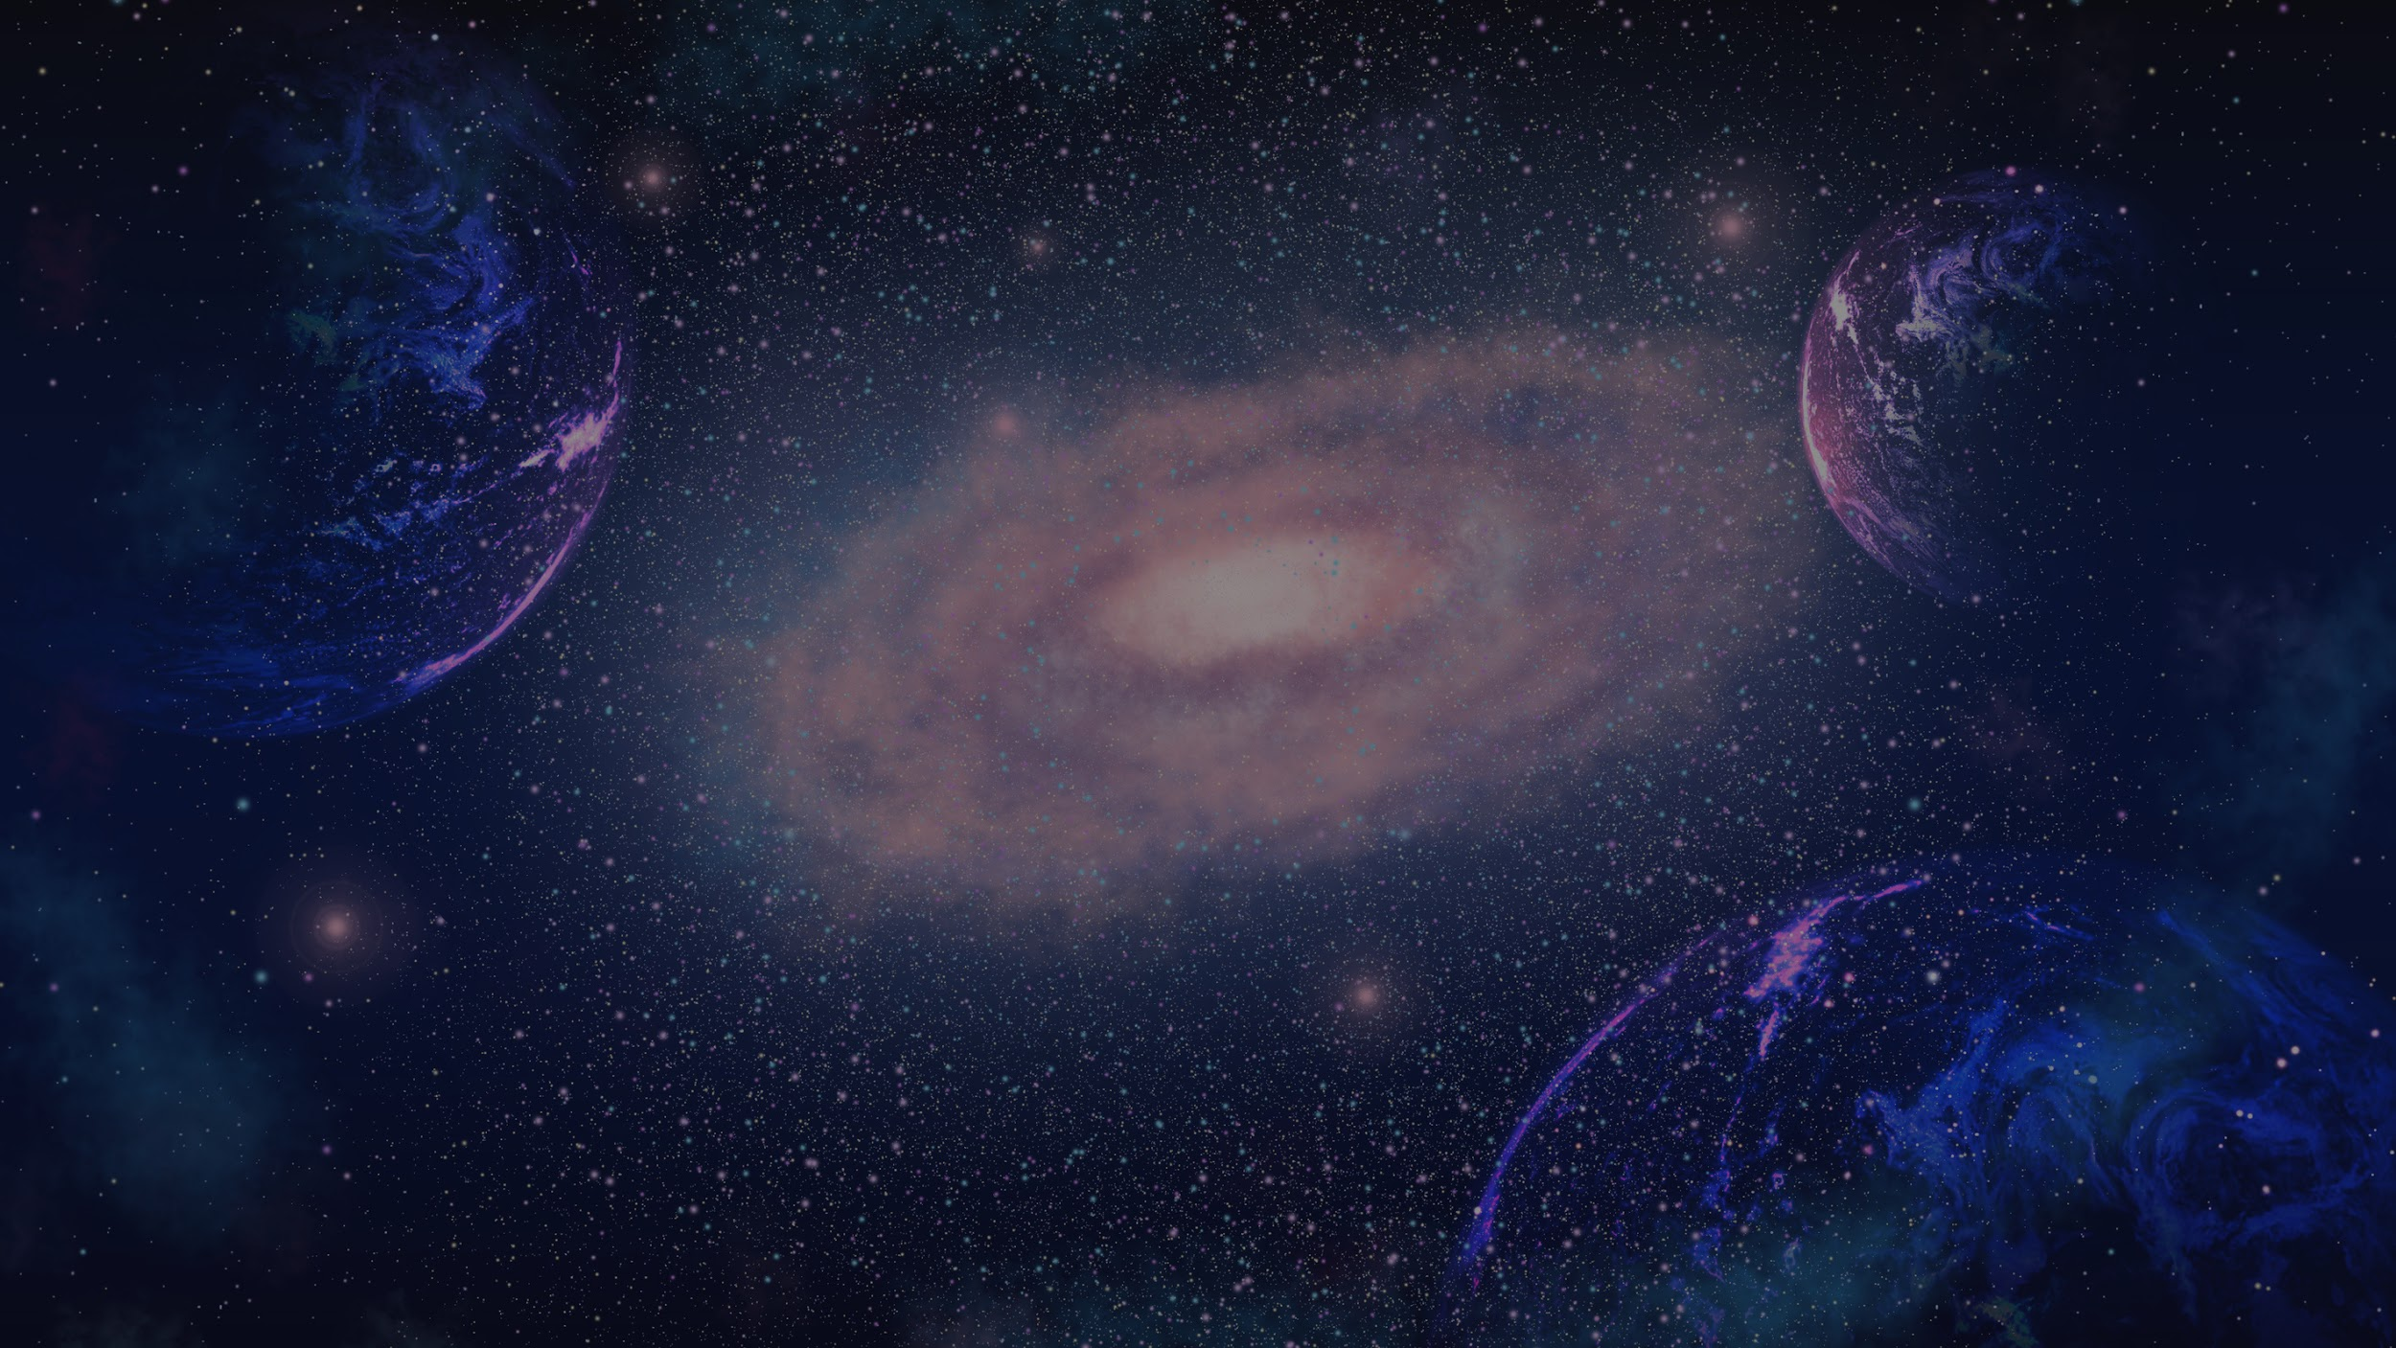
NASA SPACEAPPS CHALLENGE 2025 : A WORLD AWAY HUNTING FOR EXOPLANETS WITH AI
TEAM QUANTUM
MEMBERS: SAMADHI TALAGALA, RAVINDU KANNANGARA

Slide 2
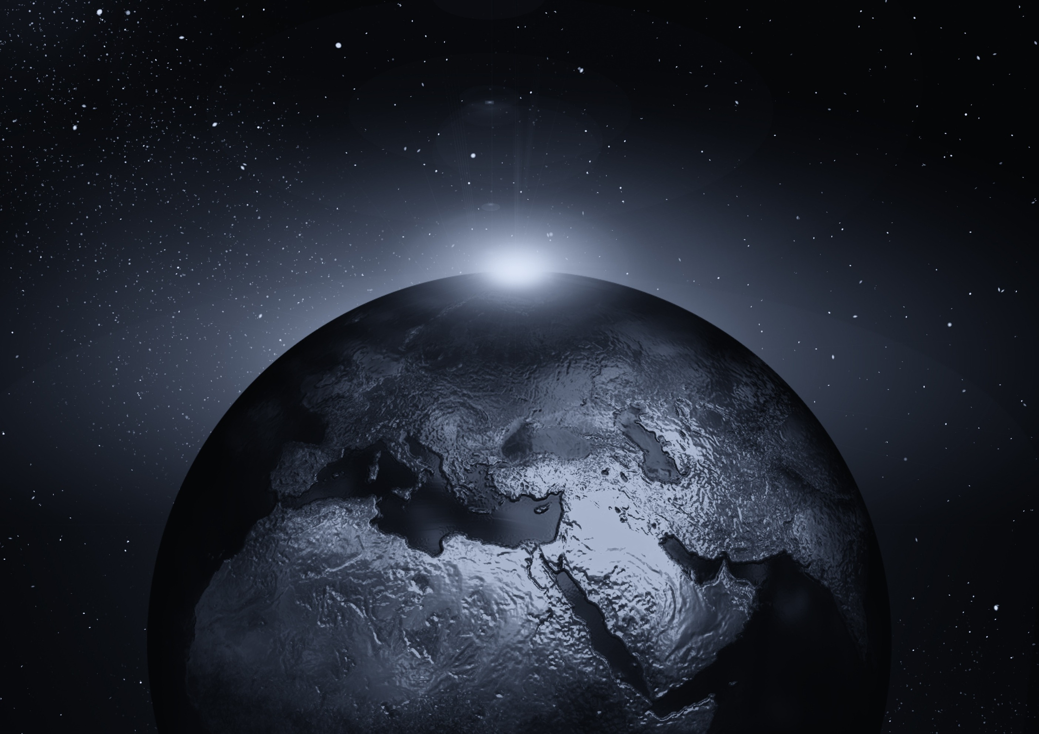
INTRODUCTION
OUR AIM IS TO CREATE A MODEL TO ANALYSE DATA FROM THE KEPLER SATELLITE: BOTH TIME SERIES AND PHYSICAL FEATURES TO DETECT EXOPLANETS
PAGE 01

Slide 3





FOR ONE MODEL, WHERE KEPLER DATA OF SEVERAL FEATURES WERE USED, WE USED A RANDOM FOREST CLASSIFIER AND CHOSE 11 FEATURES THAT WOULD MOSTLY predict whether it’s AN EXOPLANET OR NOT.
ACCURACY - 80%
MODEL METHOD
FEATURES USED :
‘koi_period',
'koi_period_err1',
'koi_period_err2',
'koi_time0bk',
'koi_time0bk_err1',
'koi_time0bk_err2',
'koi_impact',
'koi_impact_err1',
'koi_impact_err2',
'koi_duration',
'koi_duration_err1
PAGE 02

Slide 4
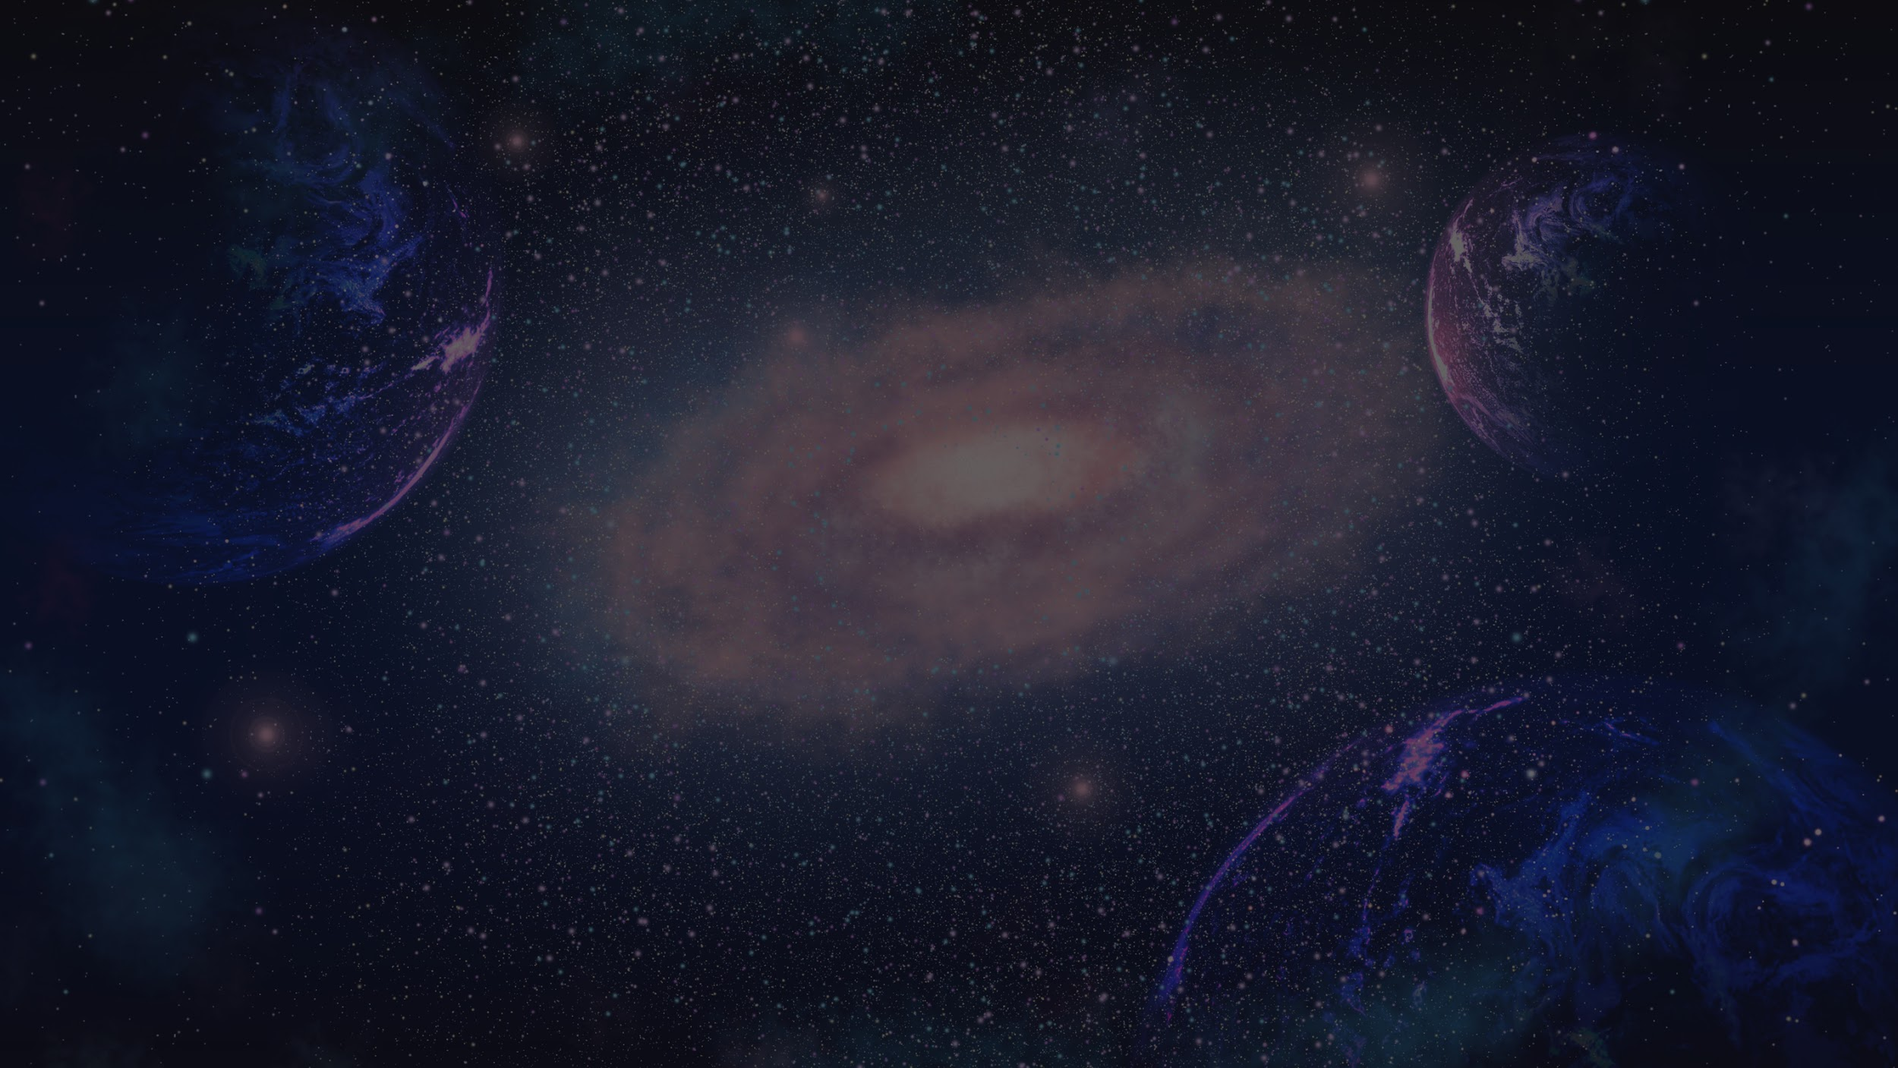
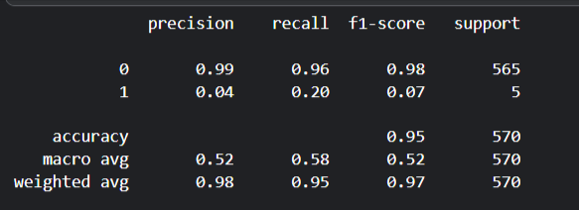
FOR THE NEXT MODEL, WHERE KEPLER TIME SERIES DATA WERE USED, WE USED A DEEP NEURAL NETWORK OF 4 LAYERS WITH DENSITIES OF EACH LAYER BEING 256, 128, 64, 1
THE DATA WAS IMBALANCED SO CLASS WEIGHTS WERE USED TO BALANCE THIS IMBALANCE, AND THE MODEL CORRECTLY IDENTIFIED ALL 5 EXOPLANETS USING THE TIME SERIES DATA. 0 REPRESENTS NON-EXOPLANETS, WHILE 1 REPRESENTS EXOPLANETS
PAGE 03

Slide 5
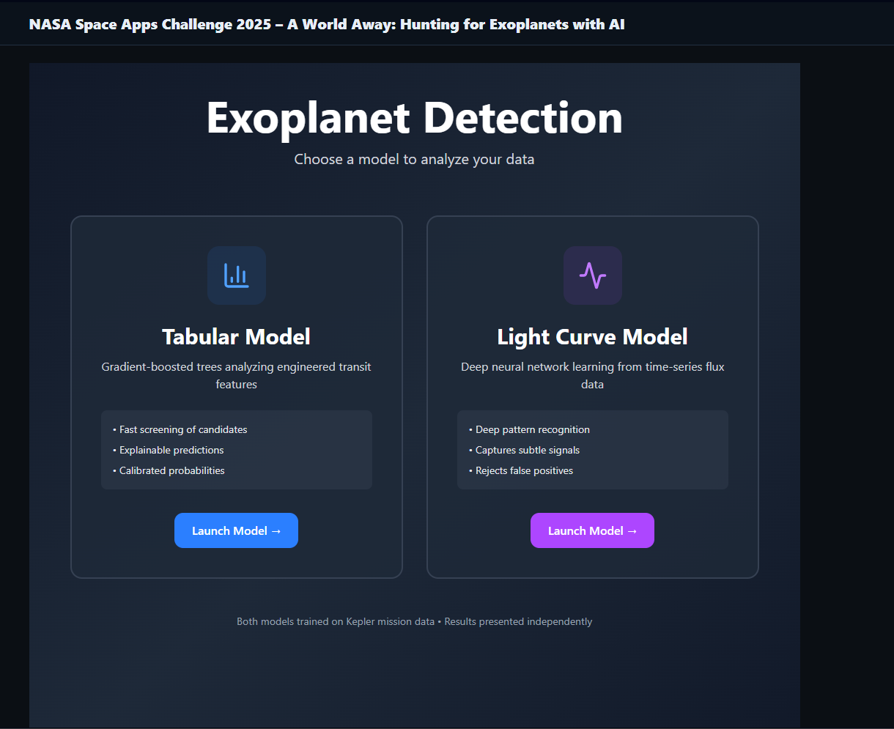
WEB DEMO
Home Page
PAGE 04

Slide 6
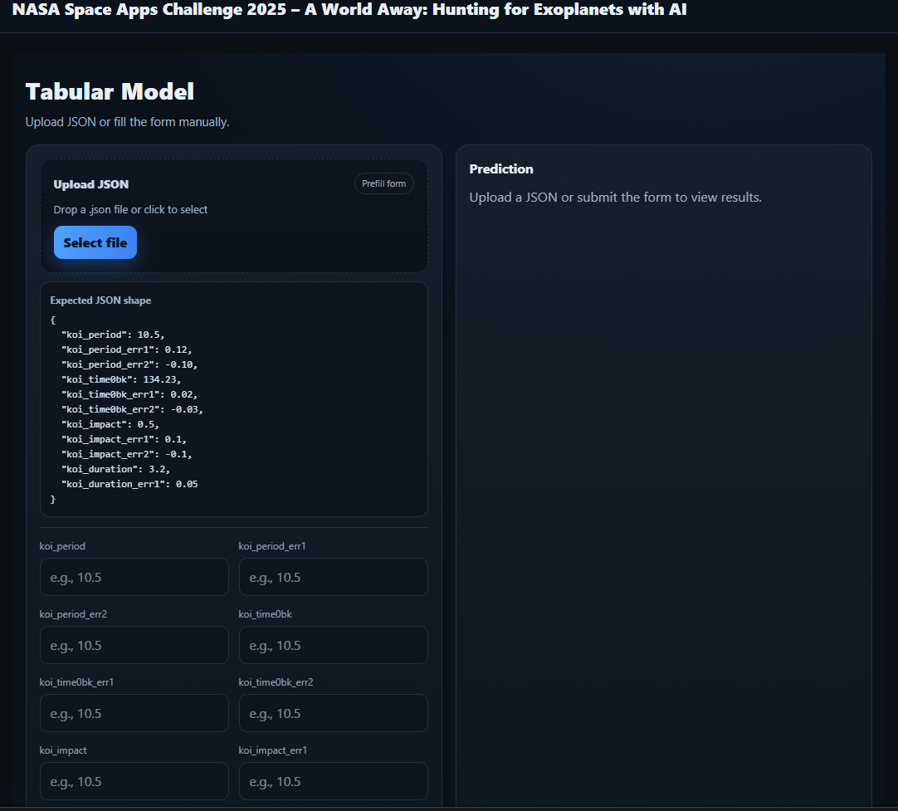
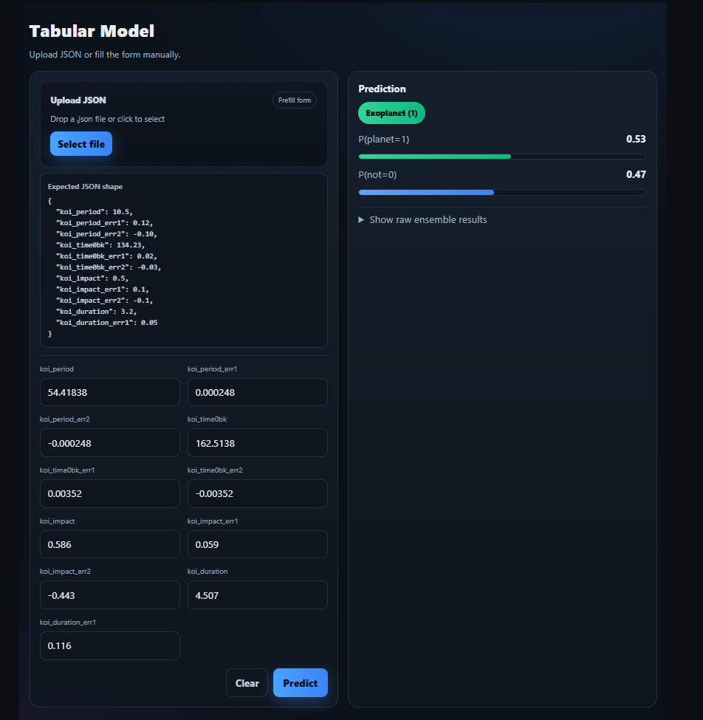
WEB DEMO
Tabular Gradient-Boosted Trees Model
PAGE 05

Slide 7
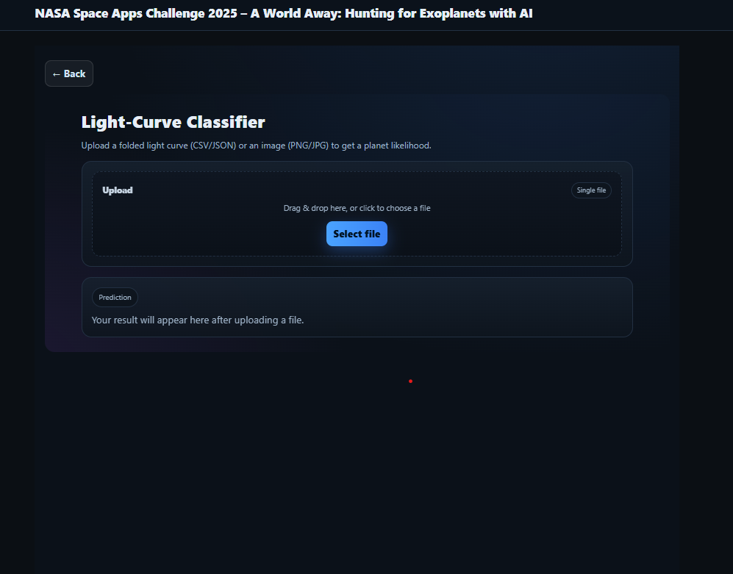
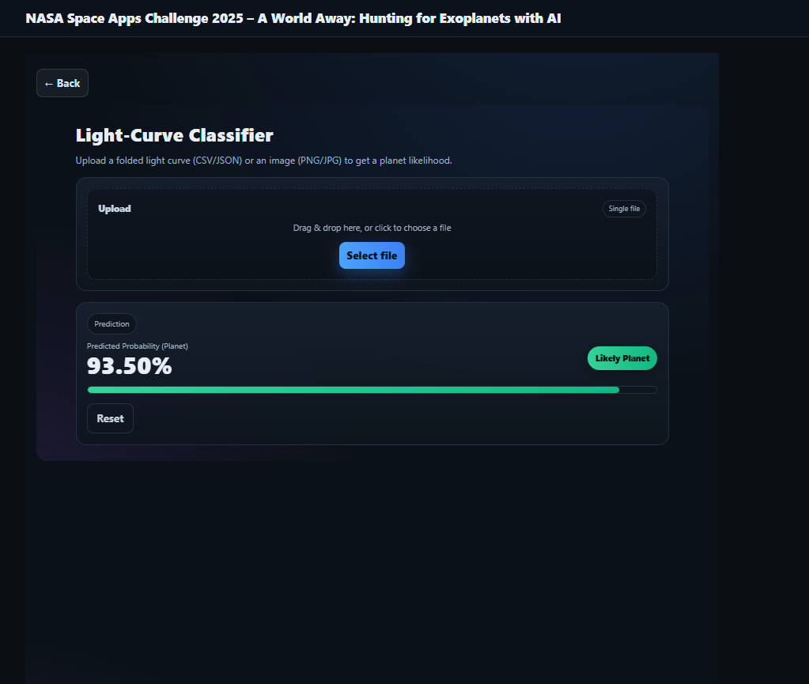
WEB DEMO
Kepler Time-Series, Deep Neural Network
PAGE 06

Slide 8




THANK YOU
PAGE 04

